Slide 1
Flowcharts

Slide 2
What is Flowchart?
A flowchart is a pictorial representation of an algorithm, workflow or process, showing the steps and their order.
Flowcharts allow us to see the process flow and its direction at first sight.
Flowchart is first developed by Herman Goldstine and John Von Newmann in the 1940’s

Slide 3
Definition of Flowchart
Flowchart is a diagram of the sequence of movements or actions of people or things involved in a complex system or activity.
Flowchart is a type of diagram representing a process using different symbols containing information about steps or a sequence of events.

Slide 4
Flowcharts
Flowchart shows the flow of the processing from the beginning to the end of a solution.
Each block in a flowchart represents one instruction or step form an algorithm.
Flowlines indicate the direction of the data flow.

Slide 5
Where flowcharts are used?
Flowcharts are used to analyze, improve, document and manage a process or a program.
Flowcharts are commonly used in developing business plans, designing algorithms and determining troubleshooting steps.

Slide 6
Purpose of Flowchart
To provide an overview of process
To allow understanding of relationships among different process steps
To collect data about a particular process
To help in decision making

Slide 7
Purpose of Flowchart
To measure the performance of a process
To depict the structure of a process
To track the process flow

Slide 8
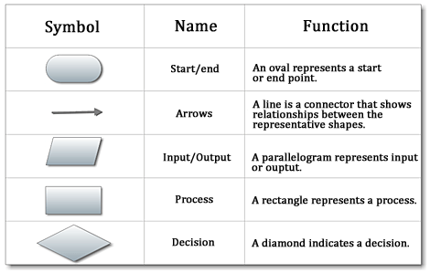
Flowchart Symbols
-

Slide 9
Guidelines for drawing flowcharts
Requirements for a flowchart should be listed out in logical order.
Flowchart should be clear, neat and easy.
Write instruction inside the block.

Slide 10
Guidelines for drawing flowcharts
Flowchart should always start at the top of the page and flows to the bottom.
If flowchart need more than one page, page connectors should used to connect parts of the flowchart.
Make the blocks big enough to write instructions so they can be easily read.

Slide 11
Advantages of using flowcharts
Communication –
    Flowcharts are better way of communicating the logic of a system to all concerned people.
Effective analysis –
    With the help of flowchart, problem can be analyzed in more effective way.

Slide 12
Advantages of using flowcharts
Proper documentation –
    Program flowcharts can be used as a good program documentation needed for various purposes.
Efficient Coding –
    Flowcharts act as a guide during the system analysis and program development phase.

Slide 13
Advantages of using flowcharts
Proper debugging –
    Flowcharts help in debugging process.
Efficient program maintenance –
    Maintenance of operating program becomes easy with the help of flowchart.

Slide 14
Limitations of using flowcharts
Complex Logic –
    If the program logic is complicated, flowchart becomes complex.
Alterations –
    If alterations are required, the flowchart may require to be redrawn completely.

Slide 15
Limitations of using flowcharts
Reproduction –
    As flowchart symbols can not be typed, reproduction of flowchart becomes very difficult.
Time consuming –
    Drawing of flowchart is time consuming.

Slide 16
Flowchart to add two numbers
START
INPUT
N1, N2
SUM← N1+N2
PRINT SUM
STOP

Slide 17
Flowchart to find square of number
START
INPUT N
SQUARE← N*N
PRINT SQUARE
STOP

